Slide 1






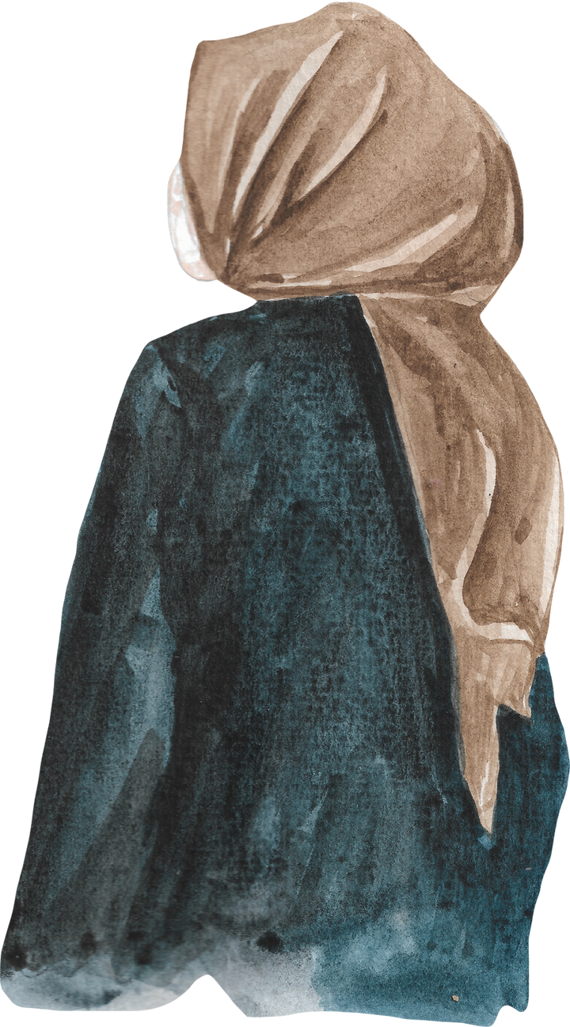

Lajna Pittsburgh
Initial Login Page
Please login:
Username:
Password:
FORGOT PASSWORD
CHANGE PASSWORD

Slide 2
Lajna Pittsburgh
Invalid Login Error, try again or check with admin for password
Try again
Username:
Password:
I
Invalid Username or Password, please try again

Slide 3
Lajna Pittsburgh
After 5 invalid password attempts, the page will lock out for a period of time for security purposes
Try again
Username:
Password:
I
Invalid Username or Password, please try again

Slide 4
Lajna Pittsburgh
Change Password:
Change your password using your previous password
Username:
Old Password:
New Password:
I
FORGOT PASSWORD
CHANGE PASSWORD

Slide 5
Lajna Pittsburgh
Change Password:
If the user forgot their password, they can reset it with a one-time code sent to their email
Username:
One-Time Code:
Reset Password:
I
FORGOT PASSWORD
CHANGE PASSWORD

Slide 6
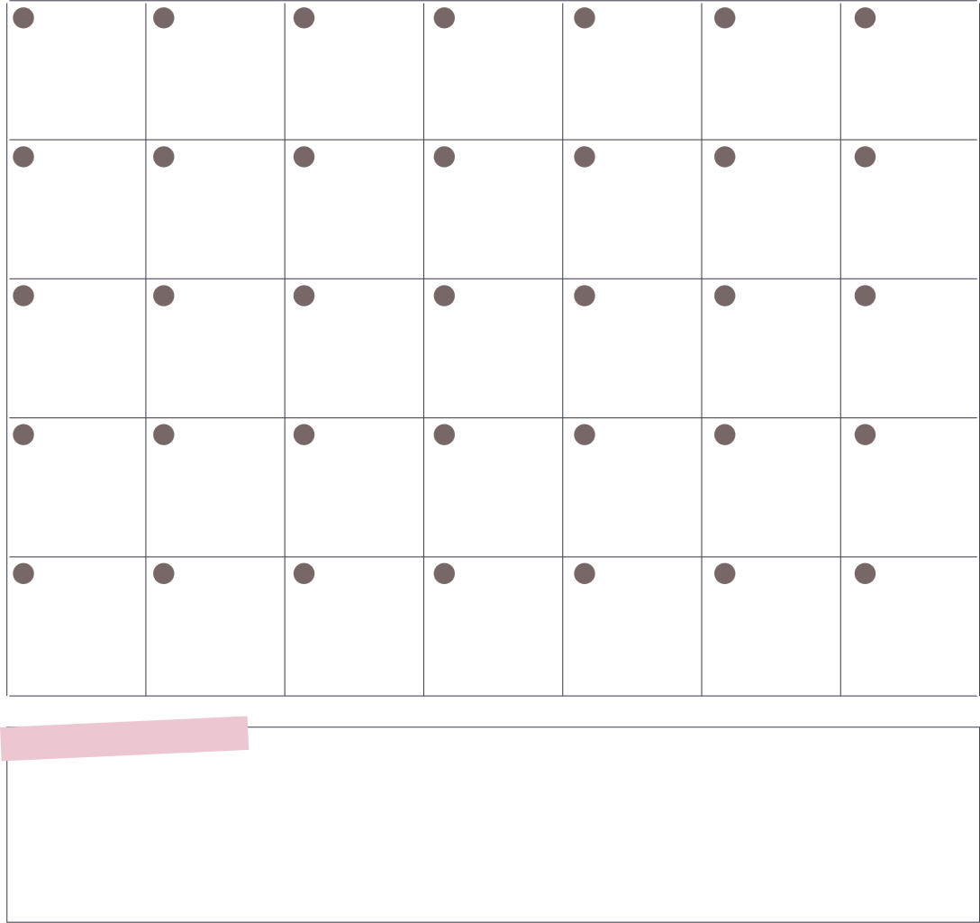





Welcome, General User
Monthly Report
Important
Reminders:
Calendar
Majlis
o Pittsburgh
Chanda payments due 10/30
Reporting Month
Sports Tournament 11/16 @ 12, make sure to register attendance!
o October 2025
Is this your first time completing this survey?
o Yes
This is what the main webpage looks like for a general user
o No
Are you a NAU MUBAI’A:
accepted Islam in last three years
Meeting Attendance:
Suggestions:
o Yes
o No
September
Which auxiliary are you from
o Lajna
October
o Nasirat
November
Next
December

Slide 7
Welcome, General User
Monthly Report
Important
Reminders:
Calendar
Monthly Report
Majlis
Chanda payments due 10/30
o Pittsburgh
Reporting Month
Sports Tournament 11/16 @ 12, make sure to register attendance!
o October 2025
Is this your first time completing this survey?
o Yes
-Report Questions Here-
o No
Are you a NAU MUBAI’A:
accepted Islam in last three years
Click on the report form box to enlarge it
Meeting Attendance:
Suggestions:
o Yes
o No
September
Which auxiliary are you from
October
o Lajna
o Nasirat
November
Next
December

Slide 8
Welcome, General User
Monthly Report
Majlis
o Pittsburgh
Reporting Month
o October 2025
Is this your first time completing this survey?
o Yes
o No
Are you a NAU MUBAI’A:
accepted Islam in last three years
o Yes
o No
Which auxiliary are you from
o Lajna
o Nasirat
Here the user can complete the monthly report form
Next
Back to Home

Slide 9
Welcome, General User
Monthly Report
Majlis
o Pittsburgh
Reporting Month
o October 2025
Is this your first time completing this survey?
o Yes
o No
Are you a NAU MUBAI’A:
accepted Islam in last three years
o Yes
o No
Here the user can complete the monthly report form
Which auxiliary are you from
o Lajna
o Nasirat
Click ‘Next’ to go through each page until the form is completed
Next
Back to Home

Slide 10
Welcome, General User
Monthly Report
Majlis
o Pittsburgh
Reporting Month
o October 2025
Is this your first time completing this survey?
o Yes
o No
Are you a NAU MUBAI’A:
accepted Islam in last three years
o Yes
o No
Which auxiliary are you from
o Lajna
o Nasirat
Click ‘Back to Home’ to return to main user webpage at any time
Next
Back to Home

Slide 11
Welcome, General User
Monthly Report
Important
Reminders:
Calendar
Monthly Report
Majlis
Chanda payments due 10/30
o Pittsburgh
Reporting Month
Sports Tournament 11/16 @ 12, make sure to register attendance!
o October 2025
Is this your first time completing this survey?
o Yes
Click on the calendar box to enlarge it
o No
-Report Questions Here-
Are you a NAU MUBAI’A:
accepted Islam in last three years
Meeting Attendance:
Suggestions:
o Yes
o No
September
Which auxiliary are you from
October
o Lajna
o Nasirat
November
Next
December

Slide 12
Welcome, General User
Opens a larger view of the calendar to see dates and plans clearly
Back to Home

Slide 13
Welcome, General User
Click ‘Back to Home’ to return to main user webpage
Back to Home

Slide 14
Welcome, Department Head
Department Report
Important
Reminders:
Calendar
Please select your department
Select
All reports due by the 5th of the month
What events were held
Department Heads meeting on Friday!
Short Answer reply
Was the syllabus followed for this month?
o Yes
o No
This is what the main webpage looks like for a Department Head
Monthly Report
Meeting Attendance:
Suggestions:
Majlis
o Pittsburgh
September
Reporting Month
o October 2025
October
Is this your first time completing this survey?
November
o Yes
o No
December

Slide 15
Welcome, Department Head
Department Report
Important
Reminders:
Department Report
Calendar
Please select your department
Select
All reports due by the 5th of the month
What events were held
-Specific Department Questions Here-
Short Answer reply
Department Heads meeting on Friday!
Was the syllabus followed for this month?
o Yes
o No
click on the department report box to enlarge it
Monthly Report
Monthly Report
Meeting Attendance:
Suggestions:
Majlis
o Pittsburgh
September
Reporting Month
-Report Questions Here-
October
o October 2025
Is this your first time completing this survey?
November
o Yes
December
o No

Slide 16
Welcome, Department Head
Department Report
Please select your department
Select
What events were held
Short Answer reply
Was the syllabus followed for this month?
o Yes
o No
Were all the rules covered?
o Yes
Here the department head can complete their respective monthly report form
o No
Next
Back to Home

Slide 17
Welcome, Department Head
Department Report
Please select your department
Select
What events were held
Short Answer reply
Was the syllabus followed for this month?
o Yes
o No
Were all the rules covered?
o Yes
o No
Click ‘Back to Home’ to return to main webpage
Next
Back to Home

Slide 18
Welcome, Department Head
Department Report
Important
Reminders:
Department Report
Department Report
Calendar
Please select your department
Select
All reports due by the 5th of the month
What events were held
-Specific Department Questions Here-
-Specific Department Questions Here-
Short Answer reply
Department Heads meeting on Friday!
Was the syllabus followed for this month?
o Yes
o No
Monthly Report
Monthly Report
Monthly Report
Meeting Attendance:
Suggestions:
Majlis
o Pittsburgh
September
-Report Questions Here-
Reporting Month
-Report Questions Here-
October
o October 2025
Is this your first time completing this survey?
November
click on the monthly report to enlarge it
o Yes
December
o No

Slide 19
Welcome, Department Head
Monthly Report
Majlis
o Pittsburgh
Reporting Month
o October 2025
Is this your first time completing this survey?
o Yes
o No
Are you a NAU MUBAI’A:
accepted Islam in last three years
o Yes
o No
Which auxiliary are you from
o Lajna
o Nasirat
Click ‘Next’ to go through each page until the form is completed
Next
Back to Home

Slide 20
Welcome, Department Head
Monthly Report
Majlis
o Pittsburgh
Reporting Month
o October 2025
Is this your first time completing this survey?
o Yes
o No
Are you a NAU MUBAI’A:
accepted Islam in last three years
o Yes
o No
Which auxiliary are you from
o Lajna
o Nasirat
Click ‘Back to Home’ to return to main user webpage at any time
Next
Back to Home

Slide 21
Welcome, Department Head
Department Report
Important
Reminders:
Calendar
Department Report
Please select your department
Select
All reports due by the 5th of the month
What events were held
-Specific Department Questions Here-
Department Heads meeting on Friday!
Short Answer reply
Was the syllabus followed for this month?
o Yes
o No
Click on the calendar box to enlarge it
Monthly Report
Monthly Report
Meeting Attendance:
Suggestions:
Majlis
o Pittsburgh
September
Reporting Month
-Report Questions Here-
o October 2025
October
Is this your first time completing this survey?
November
o Yes
o No
December

Slide 22
Welcome, Department Head
Open a larger view of the calendar to add dates and plans
Back to Home

Slide 23
Welcome, Department Head
Click ‘Back to Home’ to return to main user webpage
Back to Home

Slide 24


Welcome, Reporting Department Head
Department Report
Responses
Monthly Report
Responses
Give a new Reminder:
Calendar
Department: Education
User: Name
Majlis: Pittsburgh
enter reminder here
Reporting Month: October
Events: We held 2 ev..
Reporting Month: October
enter reminder here
Syllabus followed: yes
Nau Mubai’a: No
Auxiliary: Lajna
This is what the main webpage looks like for specifically the reporting department head
Meeting Attendance:
Review Suggestions
Monthly Report
Compliled Monthly Report
Majlis
Majlis
September
o Pittsburgh
o Pittsburgh
Reporting Month
October
suggestions shown here
Reporting Month
o October 2025
Number of ppl who surveyed:
November
o October 2025
December
25

Slide 25
Welcome, Reporting Department Head
Department Report
Responses
Monthly Report
Responses
Give a new Reminder:
Calendar
Department Report
Responses
Monthly Report
Responses
Department: Education
User: Name
Majlis: Pittsburgh
enter reminder here
Reporting Month: October
-Department Responses Here-
Reporting Month: October
enter reminder here
Events: We held 2 ev..
-The responses of users form here-
Syllabus followed: yes
Nau Mubai’a: No
Auxiliary: Lajna
Click on the Department Report to access each departments reports
Compliled Monthly Report
Meeting Attendance:
Review Suggestions
Monthly Report
Monthly Report
Compliled Monthly Report
Majlis
Majlis
September
o Pittsburgh
o Pittsburgh
-Report Questions Here-
Compilation of Report Answers here
October
Reporting Month
suggestions shown here
Reporting Month
o October 2025
Number of ppl who surveyed:
November
o October 2025
December
25

Slide 26
Welcome, Reporting Department Head
Department Report Responses
Please select your department
Select
What events were held
Here the reporting department head can see the responses of each department heads report
Short Answer reply
Was the syllabus followed for this month?
o Yes
o No
Were all the rules covered?
o Yes
o No
Click ‘Next’ to go through each page until the form is completed
Next
Back to Home

Slide 27
Welcome, Reporting Department Head
Department Report Responses
Please select your department
Select
What events were held
Short Answer reply
Was the syllabus followed for this month?
o Yes
o No
Were all the rules covered?
o Yes
o No
Click ‘Back to Home’ to return to main webpage
Next
Back to Home

Slide 28
Welcome, Reporting Department Head
Department Report
Responses
Monthly Report
Responses
Give a new Reminder:
Calendar
Department: Education
User: Name
Majlis: Pittsburgh
enter reminder here
Reporting Month: October
Events: We held 2 ev..
Reporting Month: October
enter reminder here
Syllabus followed: yes
Nau Mubai’a: No
Auxiliary: Lajna
Click on the Monthly Report Responses to see everyones responses
Meeting Attendance:
Review Suggestions
Monthly Report
Compliled Monthly Report
Majlis
Majlis
September
o Pittsburgh
o Pittsburgh
Reporting Month
October
suggestions shown here
Reporting Month
o October 2025
Number of ppl who surveyed:
November
o October 2025
December
25

Slide 29
Welcome, Reporting Department Head
Monthly Report Responses
User: Name
Majlis: Pittsburgh
Here the reporting department head can complete the responses of monthly report form
Reporting Month: October
Nau Mubai’a: No
Auxiliary: Lajna
Click ‘Next’ to go through each page until the form is completed
Next
Back to Home

Slide 30
Welcome, Reporting Department Head
Monthly Report Responses
User: Name
Majlis: Pittsburgh
Reporting Month: October
Nau Mubai’a: No
Auxiliary: Lajna
Click ‘Back to Home’ to return to main user webpage at any time
Next
Back to Home

Slide 31
Welcome, Reporting Department Head
Department Report
Responses
Monthly Report
Responses
Give a new Reminder:
Calendar
Department: Education
User: Name
Majlis: Pittsburgh
enter reminder here
Reporting Month: October
Events: We held 2 ev..
Reporting Month: October
enter reminder here
Syllabus followed: yes
Nau Mubai’a: No
Auxiliary: Lajna
Meeting Attendance:
Review Suggestions
Monthly Report
Compliled Monthly Report
Majlis
Majlis
September
o Pittsburgh
o Pittsburgh
Click on the Monthly Report for the Reporting Department Head themselves to do it
October
Reporting Month
suggestions shown here
Reporting Month
o October 2025
Number of ppl who surveyed:
November
o October 2025
December
25

Slide 32
Welcome, Reporting Department Head
Majlis
o Pittsburgh
Reporting Month
o October 2025
Is this your first time completing this survey?
o Yes
o No
Are you a NAU MUBAI’A:
accepted Islam in last three years
o Yes
o No
Which auxiliary are you from
o Lajna
o Nasirat
Click ‘Next’ to go through each page until the form is completed
Next
Back to Home

Slide 33
Welcome, Reporting Department Head
Monthly Report
Majlis
o Pittsburgh
Reporting Month
o October 2025
Is this your first time completing this survey?
o Yes
o No
Are you a NAU MUBAI’A:
accepted Islam in last three years
o Yes
o No
Which auxiliary are you from
o Lajna
o Nasirat
Click ‘Back to Home’ to return to main user webpage at any time
Next
Back to Home

Slide 34
Welcome, Reporting Department Head
Department Report
Responses
Monthly Report
Responses
Give a new Reminder:
Calendar
Department: Education
User: Name
Majlis: Pittsburgh
enter reminder here
Reporting Month: October
Events: We held 2 ev..
Reporting Month: October
enter reminder here
Syllabus followed: yes
Nau Mubai’a: No
Auxiliary: Lajna
Meeting Attendance:
Review Suggestions
Monthly Report
Compliled Monthly Report
Majlis
Majlis
September
o Pittsburgh
o Pittsburgh
Reporting Month
October
suggestions shown here
Reporting Month
o October 2025
November
Number of ppl who surveyed:
Click on the compiled monthly report box to access the report
o October 2025
December
25

Slide 35
Welcome, Reporting Department Head
Compiled Monthly Report
Majlis
o Pittsburgh
Reporting Month
o October 2025
Here the department head can compile all the responses from the monthly report into one main monthly report
Number of ppl who surveyed:
25
Number of Nau Mubai’a:
3
Number of Lajna:
18
Click ‘Next’ to go through each page until the form is completed
Next
Back to Home

Slide 36
Welcome, Reporting Department Head
Compiled Monthly Report
Majlis
o Pittsburgh
Reporting Month
o October 2025
Number of ppl who surveyed:
25
Number of Nau Mubai’a:
3
Number of Lajna:
18
Click ‘Back to Home’ to return to main user webpage at any time
Next
Back to Home

Slide 37
Welcome, Reporting Department Head
Department Report
Responses
Monthly Report
Responses
Give a new Reminder:
Calendar
Department: Education
User: Name
Majlis: Pittsburgh
enter reminder here
Reporting Month: October
Events: We held 2 ev..
Reporting Month: October
enter reminder here
Syllabus followed: yes
Nau Mubai’a: No
Auxiliary: Lajna
Click here to add a new reminder
Meeting Attendance:
Review Suggestions
Monthly Report
Compliled Monthly Report
Majlis
Majlis
September
o Pittsburgh
o Pittsburgh
Reporting Month
October
suggestions shown here
Reporting Month
o October 2025
Number of ppl who surveyed:
November
o October 2025
December
25

Slide 38
Welcome, Reporting Department Head
Add a new Reminder:
Write a new reminder and click ‘add’
Add
Back to Home

Slide 39
Welcome, Reporting Department Head
Add a new Reminder:
Add
Click ‘Back to Home’ to return to main user webpage at any time
Back to Home

Slide 40
Welcome, Reporting Department Head
Department Report
Responses
Monthly Report
Responses
Give a new Reminder:
Calendar
Department: Education
User: Name
Majlis: Pittsburgh
enter reminder here
Reporting Month: October
Events: We held 2 ev..
Reporting Month: October
enter reminder here
Syllabus followed: yes
Nau Mubai’a: No
Auxiliary: Lajna
Click here to open up the calendar
Meeting Attendance:
Review Suggestions
Monthly Report
Compliled Monthly Report
Majlis
Majlis
September
o Pittsburgh
o Pittsburgh
Reporting Month
October
suggestions shown here
Reporting Month
o October 2025
Number of ppl who surveyed:
November
o October 2025
December
25

Slide 41
Welcome, Reporting Department Head
Opens a larger view of the calendar to add dates and plans
Back to Home

Slide 42
Welcome, Reporting Department Head
Book Club at 7pm
Click on specific dates to add event information
Back to Home

Slide 43
Welcome, Reporting Department Head
Click ‘Back to Home’ to return to main user webpage
Back to Home

Slide 44
Welcome, Reporting Department Head
Department Report
Responses
Monthly Report
Responses
Give a new Reminder:
Calendar
Department: Education
User: Name
Majlis: Pittsburgh
enter reminder here
Reporting Month: October
Events: We held 2 ev..
Reporting Month: October
enter reminder here
Syllabus followed: yes
Nau Mubai’a: No
Auxiliary: Lajna
Meeting Attendance:
Review Suggestions
Monthly Report
Compliled Monthly Report
Majlis
Majlis
September
o Pittsburgh
o Pittsburgh
Reporting Month
October
suggestions shown here
Reporting Month
o October 2025
Open a larger view of the suggestions to review them
Number of ppl who surveyed:
November
o October 2025
December
25

Slide 45
Welcome, Reporting Department Head
suggestions shown here
This bigger view of the suggestions box let’s the Reporting Department Head clearly review the suggestions.
Back to Home

Slide 46
Welcome, President
Compiled Monthy Report
Give a new Reminder:
Calendar
Majlis
o Pittsburgh
enter reminder here
Reporting Month
enter reminder here
o October 2025
Number of ppl who surveyed:
25
This is what the main webpage looks like for the President
Monthly Report
Meeting Attendance:
Review Suggestions
Monthly Report
Majlis
o Pittsburgh
September
25
-Report Questions Here-
Reporting Month
-Report Questions Here-
October
37
suggestions shown here
o October 2025
Is this your first time completing this survey?
November
41
o Yes
21
December

Slide 47
Welcome, President
Compiled Monthy Report
Compiled Monthly Report
Give a new Reminder:
Calendar
Majlis
o Pittsburgh
enter reminder here
-Here is the final monthly form that the President needs to approve-
Reporting Month
enter reminder here
o October 2025
Number of ppl who surveyed:
25
Click on the completed monthly report that needs to be reviewed
Monthly Report
Meeting Attendance:
Monthly Report
Review Suggestions
Monthly Report
Majlis
o Pittsburgh
September
25
-Report Questions Here-
Reporting Month
-Report Questions Here-
-Report Questions Here-
o October 2025
October
37
suggestions shown here
Is this your first time completing this survey?
November
41
21
December

Slide 48
Welcome, President
Completed Monthly Report
Majlis
o Pittsburgh
Reporting Month
Here the President can view the final completed monthly report that is a compilation of all responses to review and finalize
o October 2025
Number of ppl who surveyed:
25
Number of Nau Mubai’a:
3
Number of Lajna:
18
Click ‘Next’ to go through each page until the form is completed
Next
Back to Home

Slide 49
Welcome, President
Completed Monthly Report
Majlis
o Pittsburgh
Reporting Month
o October 2025
Number of ppl who surveyed:
25
Number of Nau Mubai’a:
3
Number of Lajna:
18
Click ‘Back to Home’ to return to main user webpage at any time
Next
Back to Home

Slide 50
Welcome, President
Completed Monthy Report
Give a new Reminder:
Calendar
Compiled Monthy Report
Majlis
o Pittsburgh
enter reminder here
-Here is the final monthly form that the President needs to approve-
Reporting Month
enter reminder here
o October 2025
Number of ppl who surveyed:
25
Meeting Attendance:
Review Suggestions
Monthly Report
Monthly Report
Monthly Report
Majlis
September
25
o Pittsburgh
-Report Questions Here-
Click on the completed monthly report for the President to complete it themselves
-Report Questions Here-
Reporting Month
-Report Questions Here-
October
37
suggestions shown here
o October 2025
November
41
Is this your first time completing this survey?
o Yes
21
December

Slide 51
Welcome, President
Monthly Report
Majlis
o Pittsburgh
Reporting Month
o October 2025
Is this your first time completing this survey?
o Yes
o No
Are you a NAU MUBAI’A:
accepted Islam in last three years
o Yes
o No
Which auxiliary are you from
o Lajna
o Nasirat
Click ‘Next’ to go through each page until the form is completed
Next
Back to Home

Slide 52
Welcome, President
Monthly Report
Majlis
o Pittsburgh
Reporting Month
o October 2025
Is this your first time completing this survey?
o Yes
o No
Are you a NAU MUBAI’A:
accepted Islam in last three years
o Yes
o No
Which auxiliary are you from
o Lajna
o Nasirat
Click ‘Back to Home’ to return to main user webpage at any time
Next
Back to Home

Slide 53
Welcome, President
Compiled Monthy Report
Give a new Reminder:
Calendar
Majlis
o Pittsburgh
enter reminder here
Reporting Month
enter reminder here
o October 2025
Number of ppl who surveyed:
25
Click on the reminder box to add a new Reminder
Monthly Report
Meeting Attendance:
Review Suggestions
Monthly Report
Majlis
o Pittsburgh
September
25
-Report Questions Here-
Reporting Month
-Report Questions Here-
October
37
suggestions shown here
o October 2025
Is this your first time completing this survey?
November
41
o Yes
21
December

Slide 54
Welcome, President
Add a new Reminder:
Write a new reminder and click ‘add’
Add
Back to Home

Slide 55
Welcome, President
Add a new Reminder:
Add
Click ‘Back to Home’ to return to main user webpage at any time
Back to Home

Slide 56
Welcome, President
Compiled Monthy Report
Give a new Reminder:
Calendar
Majlis
o Pittsburgh
enter reminder here
Reporting Month
enter reminder here
o October 2025
Number of ppl who surveyed:
25
Click on the calendar box to open an expanded version
Monthly Report
Meeting Attendance:
Review Suggestions
Monthly Report
Majlis
o Pittsburgh
September
25
-Report Questions Here-
Reporting Month
-Report Questions Here-
October
37
suggestions shown here
o October 2025
Is this your first time completing this survey?
November
41
o Yes
21
December

Slide 57
Welcome, President
Opens a larger view of the calendar to add dates and plans
Back to Home

Slide 58
Welcome, President
Book Club at 7pm
Click on specific dates to add event information
Back to Home

Slide 59
Welcome, President
Click ‘Back to Home’ to return to main user webpage
Back to Home

Slide 60
Welcome, President
Compiled Monthy Report
Give a new Reminder:
Calendar
Majlis
o Pittsburgh
enter reminder here
Reporting Month
enter reminder here
o October 2025
Number of ppl who surveyed:
25
Monthly Report
Meeting Attendance:
Review Suggestions
Monthly Report
Majlis
o Pittsburgh
September
25
-Report Questions Here-
Reporting Month
-Report Questions Here-
October
37
suggestions shown here
o October 2025
Open a larger view of the suggestions to review them
Is this your first time completing this survey?
November
41
o Yes
21
December

Slide 61
Welcome, President
suggestions shown here
This bigger view of the suggestions box lets the President clearly go through and see the suggestions.
Back to Home

Slide 62
Welcome, President
suggestions shown here
Click ‘Back to Home’ to return to main user webpage
Back to Home

Slide 63
Welcome, Admin
View Logs:
View Compiled Monthly Report
Last Accessed:
Majlis
Monthly Report By: Sadie Sink
10/17/25
o Pittsburgh
Reminder Added By: Joyce Byers
09/30/25
Reporting Month
Monthly Report By: Zendaya Coleman
09/24/25
o October 2025
Monthly Report By: Scarlett Johansen
09/13/25
Number of ppl who surveyed:
25
Initial Admin Page
Members:
Monthly Report
Zendaya Coleman
Edit
Scarlett Johansen
Edit
Joyce Byers
-Report Questions Here-
Edit
Ariana Grande
-Report Questions Here-
Edit
Taylor Swift
Edit
Sabrina Carpenter
Edit
Hilary Clinton
Edit
Edit
Sadie Sink
Edit

Slide 64
Welcome, Admin
View Logs:
View Compiled Monthly Report
Last Accessed:
Majlis
Monthly Report By: Sadie Sink
10/17/25
o Pittsburgh
Reminder Added By: Joyce Byers
09/30/25
Reporting Month
Monthly Report By: Zendaya Coleman
09/24/25
o October 2025
Monthly Report By: Scarlett Johansen
09/13/25
Number of ppl who surveyed:
25
Click on ‘View Logs’ to open in a bigger screen
Members:
Monthly Report
Zendaya Coleman
Edit
Scarlett Johansen
Edit
Joyce Byers
-Report Questions Here-
Edit
Ariana Grande
-Report Questions Here-
Edit
Taylor Swift
Edit
Sabrina Carpenter
Edit
Hilary Clinton
Edit
Edit
Sadie Sink
Edit

Slide 65
Welcome, Admin
View Logs:
Last Accessed:
Monthly Report By: Sadie Sink
10/17/25
Reminder Added By: Joyce Byers
09/30/25
Monthly Report By: Zendaya Coleman
09/24/25
Monthly Report By: Scarlett Johansen
09/13/25
Opens a larger view of the logs
Back to Home

Slide 66
Welcome, Admin
View Logs:
Last Accessed:
Monthly Report By: Sadie Sink
10/17/25
Reminder Added By: Joyce Byers
09/30/25
Monthly Report By: Zendaya Coleman
09/24/25
Monthly Report By: Scarlett Johansen
09/13/25
Click ‘Back to Home’ to return to main user webpage
Back to Home

Slide 67
Welcome, Admin
View Logs:
View Compiled Monthly Report
Last Accessed:
Majlis
Monthly Report By: Sadie Sink
10/17/25
o Pittsburgh
Reminder Added By: Joyce Byers
09/30/25
Reporting Month
Monthly Report By: Zendaya Coleman
09/24/25
o October 2025
Monthly Report By: Scarlett Johansen
09/13/25
Number of ppl who surveyed:
25
Click on ‘View Compiled Monthly Report’ to open in a bigger screen
Members:
Monthly Report
Zendaya Coleman
Edit
Scarlett Johansen
Edit
Joyce Byers
-Report Questions Here-
Edit
Ariana Grande
-Report Questions Here-
Edit
Taylor Swift
Edit
Sabrina Carpenter
Edit
Hilary Clinton
Edit
Edit
Sadie Sink
Edit

Slide 68
Welcome, Admin
View Compiled Monthly Report
Majlis
o Pittsburgh
Reporting Month
Here the admin can view the monthly report
o October 2025
Number of ppl who surveyed:
25
Number of Nau Mubai’a:
3
Number of Lajna:
18
Click ‘Next’ to go through each page until the form is completed
Next
Back to Home

Slide 69
Welcome, Admin
View Compiled Monthly Report
Majlis
o Pittsburgh
Reporting Month
o October 2025
Number of ppl who surveyed:
25
Number of Nau Mubai’a:
3
Number of Lajna:
18
Click ‘Back to Home’ to return to main user webpage at any time
Next
Back to Home

Slide 70
Welcome, Admin
View Logs:
View Compiled Monthly Report
Last Accessed:
Majlis
Monthly Report By: Sadie Sink
10/17/25
o Pittsburgh
Reminder Added By: Joyce Byers
09/30/25
Reporting Month
Monthly Report By: Zendaya Coleman
09/24/25
o October 2025
Monthly Report By: Scarlett Johansen
09/13/25
Number of ppl who surveyed:
25
Members:
Monthly Report
Zendaya Coleman
Edit
Scarlett Johansen
Edit
Joyce Byers
Click on ‘Members’ to open the list in a bigger screen
Edit
-Report Questions Here-
Ariana Grande
-Report Questions Here-
Edit
Taylor Swift
Edit
Sabrina Carpenter
Edit
Hilary Clinton
Edit
Edit
Sadie Sink
Edit

Slide 71
Welcome, Admin
Members:
Zendaya Coleman
Edit
Scarlett Johansen
Edit
Joyce Byers
Edit
Ariana Grande
Edit
Taylor Swift
Edit
Edit
Sabrina Carpenter
Edit
Hilary Clinton
Edit
Sadie Sink
Edit
Here the admin can view the members and make any edits as needed
Next
Back to Home

Slide 72
Welcome, Admin
Members:
Zendaya Coleman
Edit
Scarlett Johansen
Edit
Joyce Byers
Edit
Ariana Grande
Edit
Taylor Swift
Edit
Edit
Sabrina Carpenter
Edit
Hilary Clinton
Edit
Sadie Sink
Edit
Click ‘Back to Home’ to return to main user webpage at any time
Next
Back to Home

